Slide 1
Java OutputStream class
Java programs use byte streams to perform input and output of 8-bit bytes.
All output byte stream classes are descended from OutputStream.
OutputStream class is an abstract class. It is the superclass of all classes representing an output stream of bytes.
OutputStream
ByteArrayOutputStream
FileOutputStream
FilterOutputStream
ObjectOutputStream
PipedOutputStream

Slide 2
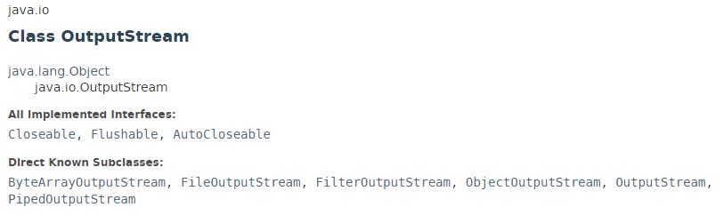

Java OutputStream class

Slide 3
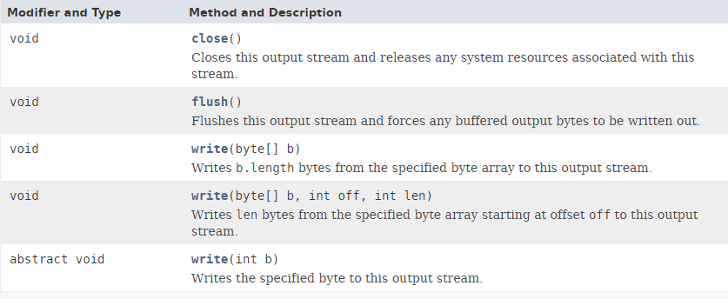
Java OutputStream class

Slide 4
Java OutputStream class
https://docs.oracle.com/javase/8/docs/api/index.html?java/io/OutputStream.html

